Slide 1
String Processing
Eric Roberts
CS 106A
February 3, 2010

Slide 2
Once upon a time . . .

Slide 3
Enigma

Slide 4


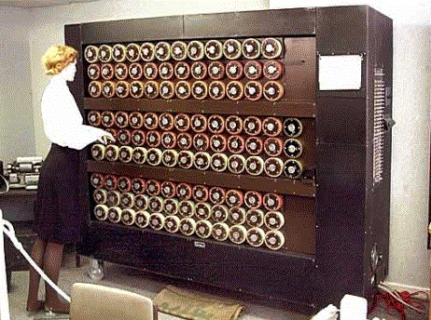
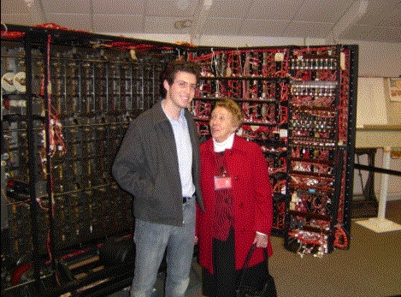
Cryptography at Bletchley Park
I have twice taught courses at Stanford in Oxford when we visited Bletchley Park, which served as the headquarters for the British decryption effort during the war.
The museum at Bletchley contains working models of the decryption machines designed by Alan Turing, just as they appeared in the Enigma trailer.
The first time around, we were lucky to have Jean Valentine, who worked in Hut 6 during the war, as our host at Bletchley.

Slide 5
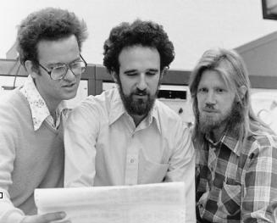
Stanford’s Contribution to Cryptography
Stanford has long been in the forefront of cryptographic research. In 1976, Professor Martin Hellman and his students Ralph Merkle and Whitfield Diffie developed public-key cryptography, which revolutionized the process of coding messages.
Although Hellman, Diffie, and Merkle were granted a U.S. patent for their work, it turns out that much the same technology was invented in England by the successor to the Government Code and Cipher School at Bletchley Park. That work, however, remained classified until the 1990s and had no commercial impact.
Merkle/Hellman/Diffie in 1976

Slide 6
String Processing

Slide 7





Encryption
Twas brillig, and the slithy toves,
Did gyre and gimble in the wabe:
Doo plpvb zhuh wkh erurjryhv,
Lfr gax wvwx clgat vngeclzx.
A
B
C
D
E
F
G
H
I
J
K
L
M
N
O
P
Q
R
S
T
U
V
W
X
Y
Z
L
Z
D
R
X
P
E
A
J
Y
B
Q
W
F
V
I
H
C
T
G
N
O
M
K
S
U
Twas brillig, and the slithy toves,
Twas brillig, and the slithy toves,
Did gyre and gimble in the wabe:
Did gyre and gimble in the wabe:
All mimsy were the borogoves,
All mimsy were the borogoves,
And the mome raths outgrabe.
And the mome raths outgrabe.

Slide 8
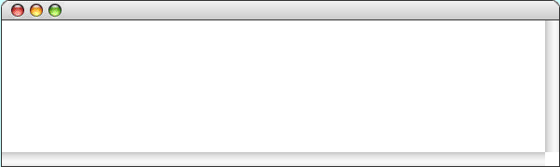
Creating a Caesar Cipher
public void run() {
println("This program implements a Caesar cipher.");
int key = readInt("Character positions to shift: ");
String plaintext = readLine("Enter a message: ");
String ciphertext = encodeCaesarCipher(plaintext, key);
println("Encoded message: " + ciphertext);
}
public void run() {
println("This program implements a Caesar cipher.");
int key = readInt("Character positions to shift: ");
String plaintext = readLine("Enter a message: ");
String ciphertext = encodeCaesarCipher(plaintext, key);
println("Encoded message: " + ciphertext);
}
private String encodeCaesarCipher(String str, int key) {
if (key < 0) key = 26 - (-key % 26);
String result = "";
for (int i = 0; i < str.length(); i++) {
char ch = str.charAt(i);
if (Character.isUpperCase(ch)) {
ch = (char) ('A' + (ch - 'A' + key) % 26);
}
result += ch;
}
return result;
}
key
key
plaintext
str
ciphertext
result
3
3
JABBERWOCKY
JABBERWOCKY
MDEEHUZRFNB
MDEEHUZRFNB
74
65
89
65
65
65
12
3
27
3
3
-
3
-
-
+
+
+
ch
i
result
str
key
'J'
'M'
'A'
'D'
'B'
'E'
'B'
'E'
'R'
'U'
'W'
'Z'
'O'
'R'
'C'
'F'
'Y'
'B'
0
1
2
3
4
5
11
M
MD
MDE
MDEE
MDEEH
'E'
MDEEHU
'H'
'K'
'N'
6
7
8
9
10
MDEEHUZ
MDEEHUZR
MDEEHUZRF
MDEEHUZRFN
MDEEHUZRFNB
JABBERWOCKY
3
CaesarCipher
This program implements a Caesar cipher.
Character positions to shift:
3
Enter a message:
JABBERWOCKY
Encoded message: MDEEHUZRFNB
skip simulation

Slide 9
Exercise: Letter Substitution Cipher
One of the simplest types of codes is a letter-substitution cipher, in which each letter in the original message is replaced by some different letter in the coded version of that message. In this type of cipher, the key is often presented as a sequence of 26 letters that shows how each of the letters in the standard alphabet are mapped into their enciphered counterparts:
A
B
C
D
E
F
G
H
I
J
K
L
M
N
O
P
Q
R
S
T
U
V
W
X
Y
Z
|
|
|
|
|
|
|
|
|
|
|
|
|
|
|
|
|
|
|
|
|
|
|
|
|
|
L
Z
D
R
X
P
E
A
J
Y
B
Q
W
F
V
I
H
C
T
G
N
O
M
K
S
U
LetterSubstitutionCipher
Letter-substitution cipher.
Enter 26-letter key:
LZDRXPEAJYBQWFVIHCTGNOMKSU
Plaintext:
LEWIS CARROLL
Ciphertext: QXMJT DLCCVQQ

Slide 10
A Case Study in String Processing
Section 8.5 works through the design and implementation of a program to convert a sentence from English to Pig Latin. At least for this dialect, the Pig Latin version of a word is formed by applying the following rules:
1.
If the word begins with a consonant, you form the Pig Latin version by moving the initial consonant string to the end of the word and then adding the suffix ay, as follows:
scr
scr
scr
scr
scr
scr
scr
scr
scr
scr
scr
scr
scr
scr
scr
scr
scr
scr
scr
scr
scr
scr
scr
scram
am
scr
am
am
am
am
am
am
am
am
am
am
am
am
am
am
am
am
am
am
am
am
am
scr
scr
ay
am
am
am
am
2.
If the word begins with a vowel, you form the Pig Latin version simply by adding the suffix way, like this:
apple
apple
way

Slide 11
Starting at the Top
In accordance with the principle of top-down design, it makes sense to start with the run method, which has the following pseudocode form:
public void run() {
Tell the user what the program does.
Ask the user for a line of text.
Translate the line into Pig Latin and print it on the console.
}
This pseudocode is easy to translate to Java, as long as you are willing to include calls to methods you have not yet written:
public void run() {
println("This program translates a line into Pig Latin.");
String line = readLine("Enter a line: ");
println(translateLine(line));
}

Slide 12
Designing translateLine
The translateLine method must divide the input line into words, translate each word, and then reassemble those words.
Although it is not hard to write code that divides a string into words, it is easier still to make use of existing facilities in the Java library to perform this task. One strategy is to use the StringTokenizer class in the java.util package, which divides a string into independent units called tokens. The client then reads these tokens one at a time. The set of tokens delivered by the tokenizer is called the token stream.
The precise definition of what constitutes a token depends on the application. For the Pig Latin problem, tokens are either words or the characters that separate words, which are called delimiters. The application cannot work with the words alone, because the delimiter characters are necessary to ensure that the words don’t run together in the output.

Slide 13
The StringTokenizer Class
The constructor for the StringTokenizer class takes three arguments, where the last two are optional:
  A string indicating the source of the tokens.
  A string which specifies the delimiter characters to use. By default, the delimiter characters are set to the whitespace characters.
  A flag indicating whether the tokenizer should return delimiters as part of the token stream. By default, a StringTokenizer ignores the delimiters.
Once you have created a StringTokenizer, you use it by setting up a loop with the following general form:
while (tokenizer.hasMoreTokens()) {
String token = tokenizer.nextToken();
code to process the token
}

Slide 14
The translateLine Method
The existence of the StringTokenizer class makes it easy to code the translateLine method, which looks like this:
private String translateLine(String line) {
String result = "";
StringTokenizer tokenizer =
new StringTokenizer(line, DELIMITERS, true);
while (tokenizer.hasMoreTokens()) {
String token = tokenizer.nextToken();
if (isWord(token)) {
token = translateWord(token);
}
result += token;
}
return result;
}
The DELIMITERS constant is a string containing all the legal punctuation marks to ensure that they aren’t combined with the words.

Slide 15
The translateWord Method
The translateWord method consists of the rules for forming Pig Latin words, translated into Java:
private String translateWord(String word) {
int vp = findFirstVowel(word);
if (vp == -1) {
return word;
} else if (vp == 0) {
return word + "way";
} else {
String head = word.substring(0, vp);
String tail = word.substring(vp);
return tail + head + "ay";
}
}
The remaining methods (isWord and findFirstVowel) are both straightforward. The simulation on the following slide simply assumes that these methods work as intended.

Slide 16
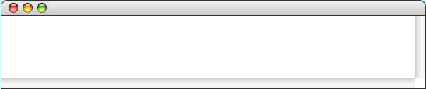
The PigLatin Program
public void run() {
println("This program translates a line into Pig Latin.");
String line = readLine("Enter a line: ");
println( translateLine(line) );
}
public void run() {
println("This program translates a line into Pig Latin.");
String line = readLine("Enter a line: ");
println( translateLine(line) );
}
private String translateLine(String line) {
String result = "";
StringTokenizer tokenizer =
new StringTokenizer(line, DELIMITERS, true);
while ( tokenizer.hasMoreTokens() ) {
String token = tokenizer.nextToken();
if ( isWord(token) ) token = translateWord(token);
result += token;
}
return result;
}
private String translateWord(String word) {
int vp = findFirstVowel(word);
if ( vp == -1 ) {
return word;
} else if ( vp == 0 ) {
return word + "way";
} else {
String head = word.substring(0, vp);
String tail = word.substring(vp);
return tail + head + "ay";
}
}
private String translateWord(String word) {
int vp = findFirstVowel(word);
if ( vp == -1 ) {
return word;
} else if ( vp == 0 ) {
return word + "way";
} else {
String head = word.substring(0, vp);
String tail = word.substring(vp);
return tail + head + "ay";
}
}
private String translateWord(String word) {
int vp = findFirstVowel(word);
if ( vp == -1 ) {
return word;
} else if ( vp == 0 ) {
return word + "way";
} else {
String head = word.substring(0, vp);
String tail = word.substring(vp);
return tail + head + "ay";
}
}
private String translateWord(String word) {
int vp = findFirstVowel(word);
if ( vp == -1 ) {
return word;
} else if ( vp == 0 ) {
return word + "way";
} else {
String head = word.substring(0, vp);
String tail = word.substring(vp);
return tail + head + "ay";
}
}
line
line
this is pig latin.
this is pig latin.
tokenizer
this is pig latin.
this is pig latin.
this is pig latin.
this is pig latin.
this is pig latin.
this is pig latin.
this is pig latin.
this is pig latin.
this is pig latin.
this is pig latin.
token
result
line
this
is
pig
latin
.
isthay
isway
igpay
atinlay
isthay
isthay
isthay isway
isthay isway
isthay isway igpay
isthay isway igpay
isthay isway igpay atinlay
isthay isway igpay atinlay.
this is pig latin.
vp
vp
vp
head
head
head
tail
tail
tail
word
word
vp
head
tail
word
word
this
is
2
pig
0
1
th
p
is
1
l
ig
latin
atin
PigLatin
This program translates a line into Pig Latin.
Enter a line:
this is pig latin.
isthay isway igpay atinlay.
skip simulation

Slide 17
The End

